Slide 1


Presentation Essentials: Mastering Your Project Demo
A successful presentation showcases your project's impact, demonstrating your understanding and skills. This guide offers tips for creating a clear, engaging, and informative demonstration.
by Ngo Hoai Nam (BTEC HN)

Slide 2
Preparation is Key: Setting the Stage
Project Overview
Audience Engagement
Start with a concise introduction outlining the project's purpose, goals, and the problem it addresses.
Tailor your presentation to your audience. Consider their background and understanding of the topic.

Slide 3
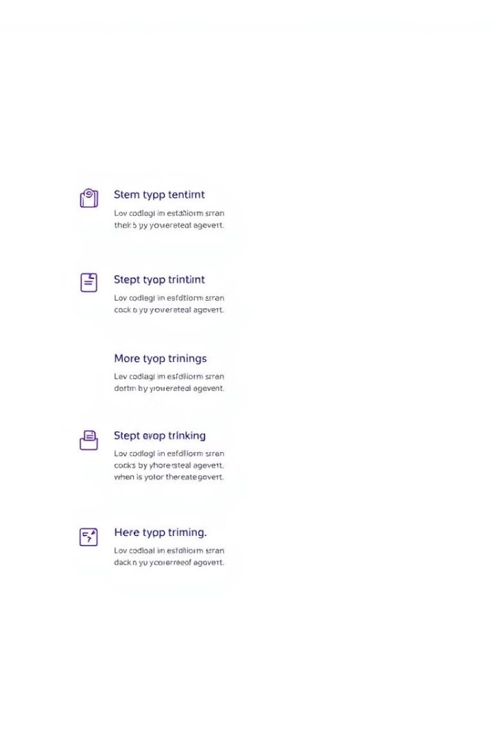
Structuring Your Presentation: Building a Narrative
1
Introduction
Grab attention with an engaging opening. Briefly introduce the project and its relevance.
2
Body
Break down the presentation into logical sections. Use clear headings and visuals to guide the audience.
3
Conclusion
Summarize key takeaways and highlight the project's impact. End with a call to action.

Slide 4


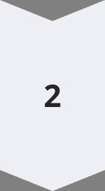
Demonstration: Bringing Your Project to Life
Live Demo
Walk through the system's features, highlighting its functionality. Use real-world examples to demonstrate its application.
Visual Aids
Utilize screenshots, videos, or diagrams to illustrate complex concepts or features. This enhances understanding and engagement.

Slide 5

Clarity and Conciseness: Communicating Effectively
Language
Pace
Use clear, concise language that is easy to understand. Avoid jargon or overly technical terms.
Speak at a moderate pace. Allow time for pauses and questions to ensure understanding.

Slide 6
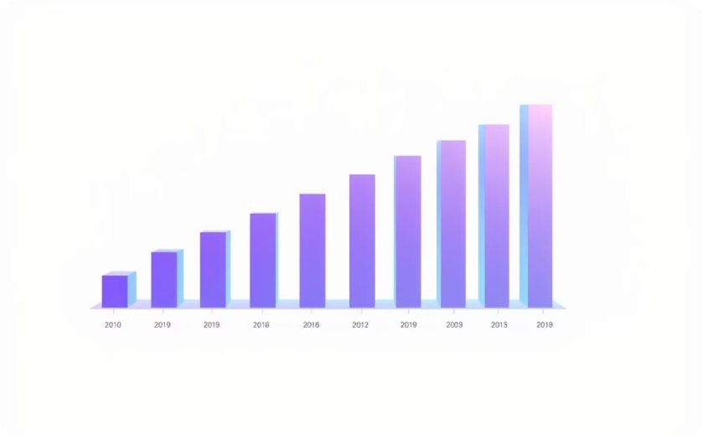
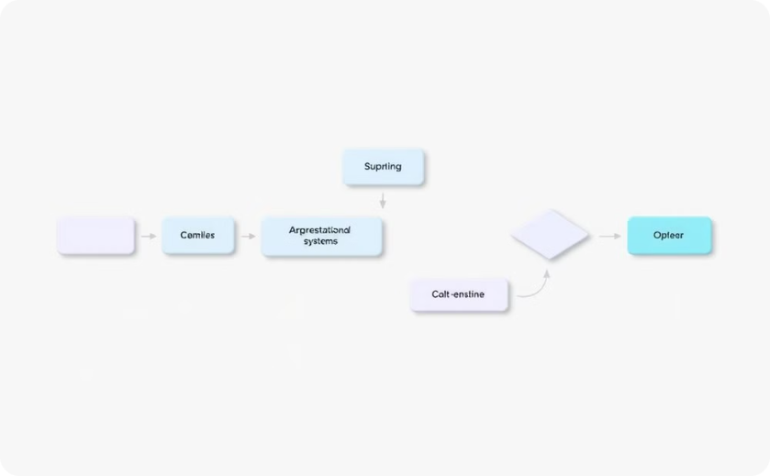
Visual Storytelling: Engaging the Audience
Data Visualization
Diagrams and Flowcharts
Use graphs, charts, or tables to present data effectively. They can illustrate trends, relationships, or key findings.
Visual aids can simplify complex processes and make them easier to understand.

Slide 7
Practice Makes Perfect: Building Confidence
Rehearse
1
Practice your presentation several times. This helps you gain confidence and identify areas for improvement.
Feedback
2
Seek feedback from friends, classmates, or mentors. Their perspectives can help you refine your presentation.

Slide 8



Q&A: Engaging in Dialogue
Listen Carefully
1
Pay attention to the question and try to understand it fully.
Answer Concisely
2
Provide clear and concise answers, staying on topic.
Be Respectful
3
Acknowledge and respect all questions, even if you don't have a complete answer.

Slide 9

Conclusion: Leaving a Lasting Impression
1
Summarize Key Points
2
Call to Action
Reiterate the project's purpose, main findings, and its significance.
Encourage the audience to engage with the project or learn more.

Slide 10



Moving Forward: Continuous Learning
Stay Informed
Seek Feedback
Stay updated on the latest technologies and trends in your field.
Actively seek feedback on your work and presentations to continuously improve.

